Slide 1


Final Project: Image Object Co-Localization
王石平，教授/博导/旗山学者
数学与计算机科学学院

Slide 2
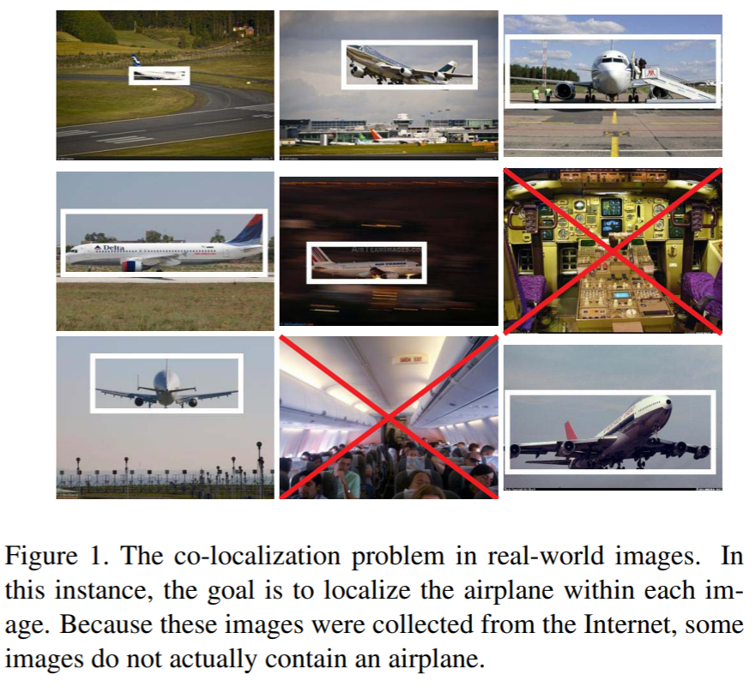
§ Object Co-Localization

Slide 3
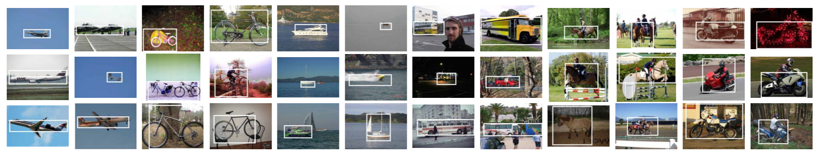
§ Experimental Results

Slide 4
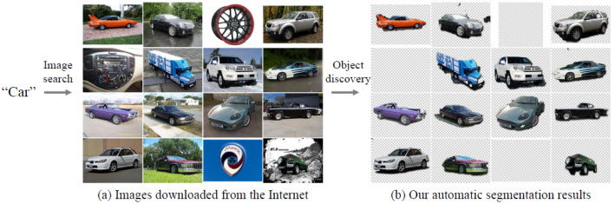
§ ObjectDiscovery data description
Airplane: 4,542 images
Car: 4,537
Horse: 6,841

Slide 5
§ Project Baseline
Contact me if ACC is 80%+ using your own method.
This project is optional.

